Slide 1





TOPIC:
SIMULATING LIGHTNING
Edward Raphael (2702355391)
Harry Chiu (2702357882)

Slide 2
Physical Process
Table of Contents
1
Physics Domain
2
Mathematical Process
3
Application
4
Outcome
5

Slide 3

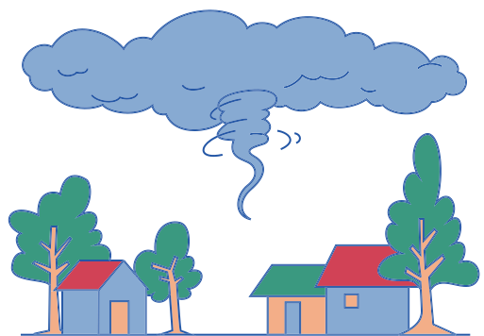

Physical Process
How Lightning strikes
For lightning strikes to occur, it requires electric discharges between electricly charged regions withing the atmosphere or between the atmosphere and the ground.
Lightning Formation
During a thunderstorm, updrafts and downdrafts caused by turbulent winds seperates the electical charge in a cloud. Making negative charges accumulate at the cloud’s base while positive charges accumulate at the top, creating strong electric fields.
Lightning Discharge
As opposite charges attract, positive charges on the ground gets attracted to the cloud’s base, accumulating in tall objects such as trees and building. A lightning strike begins with,
A stepped leader, a channel of ionized air that propagates downward in steps until it reaches the ground.
An upward streamer of positive charge rises to meet it completing the conductive path.
Return stroke is the triggered, where massive currents flow upward, producing the bright flash. The extreme heat from the plasma channel causes rapid air expansion, creating a shockwave known as thunder.

Slide 4




Field of physics related to Lighting strikes
Physics Domain
Electromagnetism,
Thermodynamics,
Plasma physics,
Concepts and theories
Coloumb’s Law,
Electrostatics,
Gauss’s Law,
Lorentz Force Law,.

Slide 5





Mathematical Background
Poisson’s equation
Electric Field
∇²Φ = -ρ/ε₀
Φ: Electric potential (V)
ρ: Charge density (C/m³)
ε₀: Permittivity of free space (8.85 × 10⁻¹² F/m)
Calculates the electric potential, giving the voltage distribution.
E = -∇Φ
E: Electric field (V/m)
∇Φ: Gradient of electric potential
Determines how the charges will move and identify where the striker will occur.

Slide 6




Mathematical Background
Condiitions
Considerations
E ≥ E breakdown
Lightning starts when the electric field exceeds 3.0 x 10^6 V/m
We can also implement the affect of tall buildings since they enhance the electric field within the area.

Slide 7



Applications
Plasma Physics - Understand Controlled Discharges
Simulating the natural branching patterns
Weather Prediction

Slide 8


outcomes
Simulate lightning patterns (2D)
Identify the behavior of lightning under scenarios
Validate the laws of electric discharge

Slide 9
Thank you!

Slide 10


References
https://www.canada.ca/en/environment-climate-change/services/lightning/science/how-lightning-works.
https://www.britannica.com/science/lightning-meteorology
https://www.physicsclassroom.com/class/estatics/lesson-4/lightning

